Slide 1


Scholarship Program
Educational opportunity for employee’s dependent children – trade, technical, vocational or traditional university programs
Program opens mid-October of each year Submission deadline: around the 20th of February
Global program for all eligible employees (with one year of service as of 20 April year of application deadline)
Assistance ranges from $2,000 – $10,000(USD)
Awards to all global new recipients are scholarships. US employees have the opportunity to elect additional loan coverage
Scholarship America partners with Ida Koran
Notes:
As mentioned earlier, the other way Ida Koran provides support to employee families is through our scholarship program. This program is for dependent children of Ecolab employees pursuing post-secondary education. The program opens every October with a deadline of mid-February. Assistance ranges from $2,000 to $10,000 and we are in discussions with Scholarship America to raise the award levels.

Slide 2
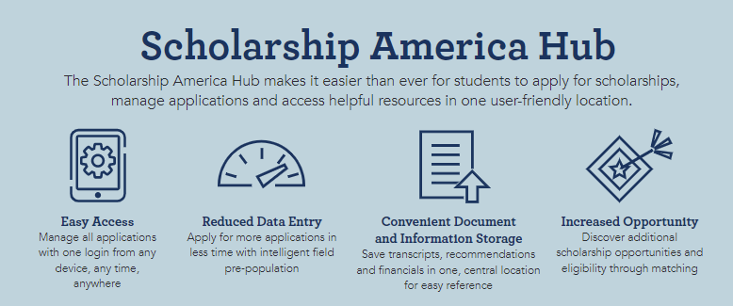
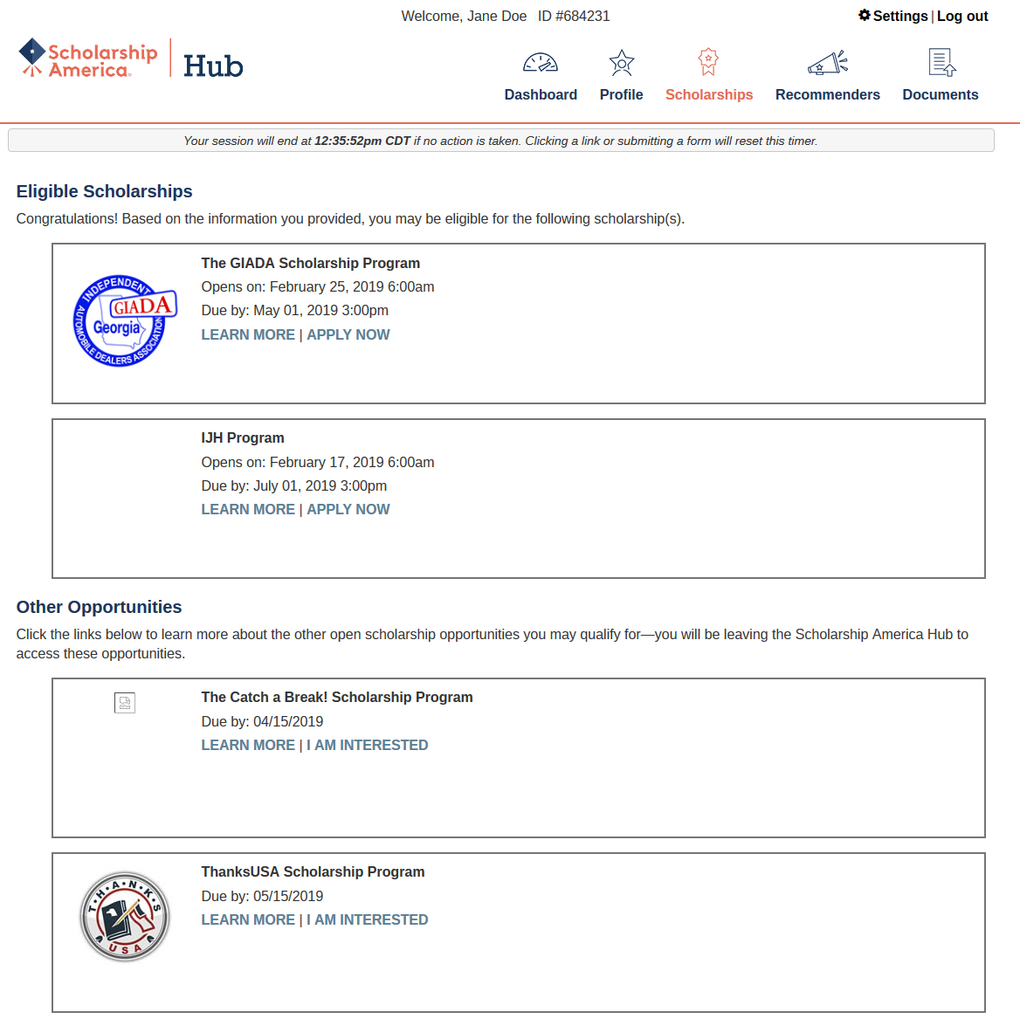
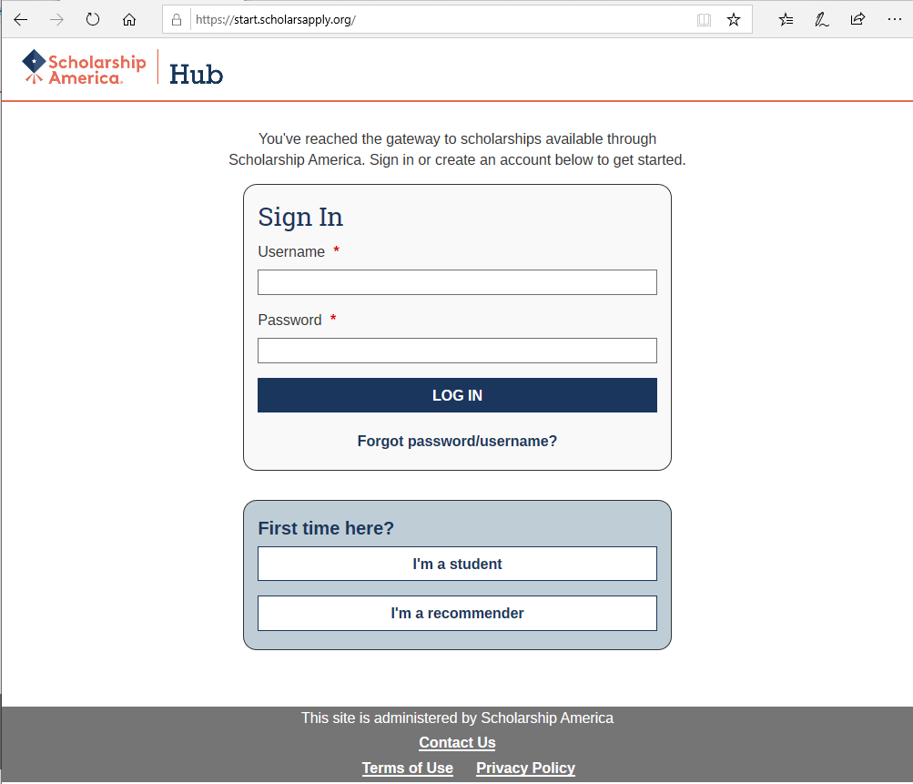
How to Apply to Scholarship Program
Notes:
Applying to the scholarship program y clicking the apply now icon on Ida’s website with the graduation cap. The applicant is the student –not the parent.
They will be directed to the Scholarship America application portal will they will establish a master account and complete a questionnaire. This information is used to recommend scholarship programs including Ida Koran. If the student enters their graduation date incorrectly, often times the portal does not recommend Ida’s program. However, the student can edit the information and the program should appear.
Students are also encouraged to apply to the other programs that are recommended for them by the portal.

Slide 3
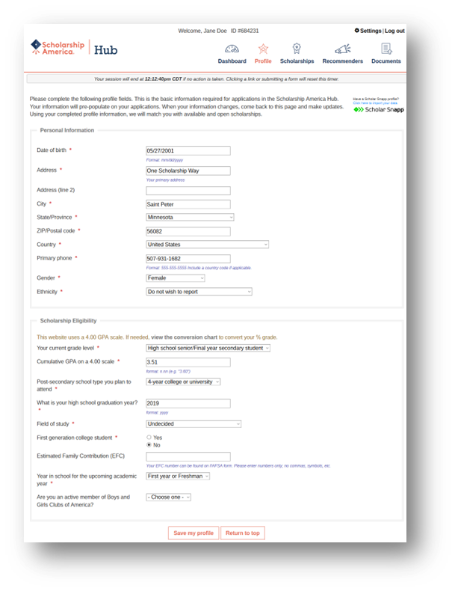
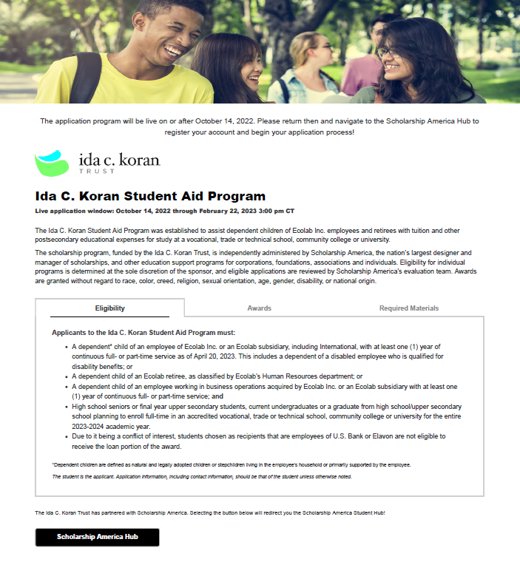
Ida Koran Landing page

Slide 4

Scholarship Program – student evaluations
Applications are evaluated by Scholarship America
Students are evaluated on 50% academics & 50% extra-curricular, work, special circumstances
No longer requiring recommendation
Student applicants must lock and submit their applications
SA sends out 2 reminders to students prior to deadline
Notification to students 2nd week in May
Notes:
The application deadline for submission is 20 February
Recommender evaluations are no longer required. Once the student is finished, they must lock and submit the application. A pop up confirmation will appear when the application has been submitted. Students are send two reminders to finish their applications starting 4 weeks before the deadline.
The applications are evaluated by SA’s team of advisors. They evaluate the students application for academic excellence and extracurricular/work/volunteer/special circumstances. Those students with the highest evaluation scores are then evaluated for financial need.
Students are notified the second week of May of their status. Note that Ida Koran is allowed to selected 1 application for every 4 that have been received due to IRS guidelines. The larger the application pool, the more awards we can provide.

