Slide 1
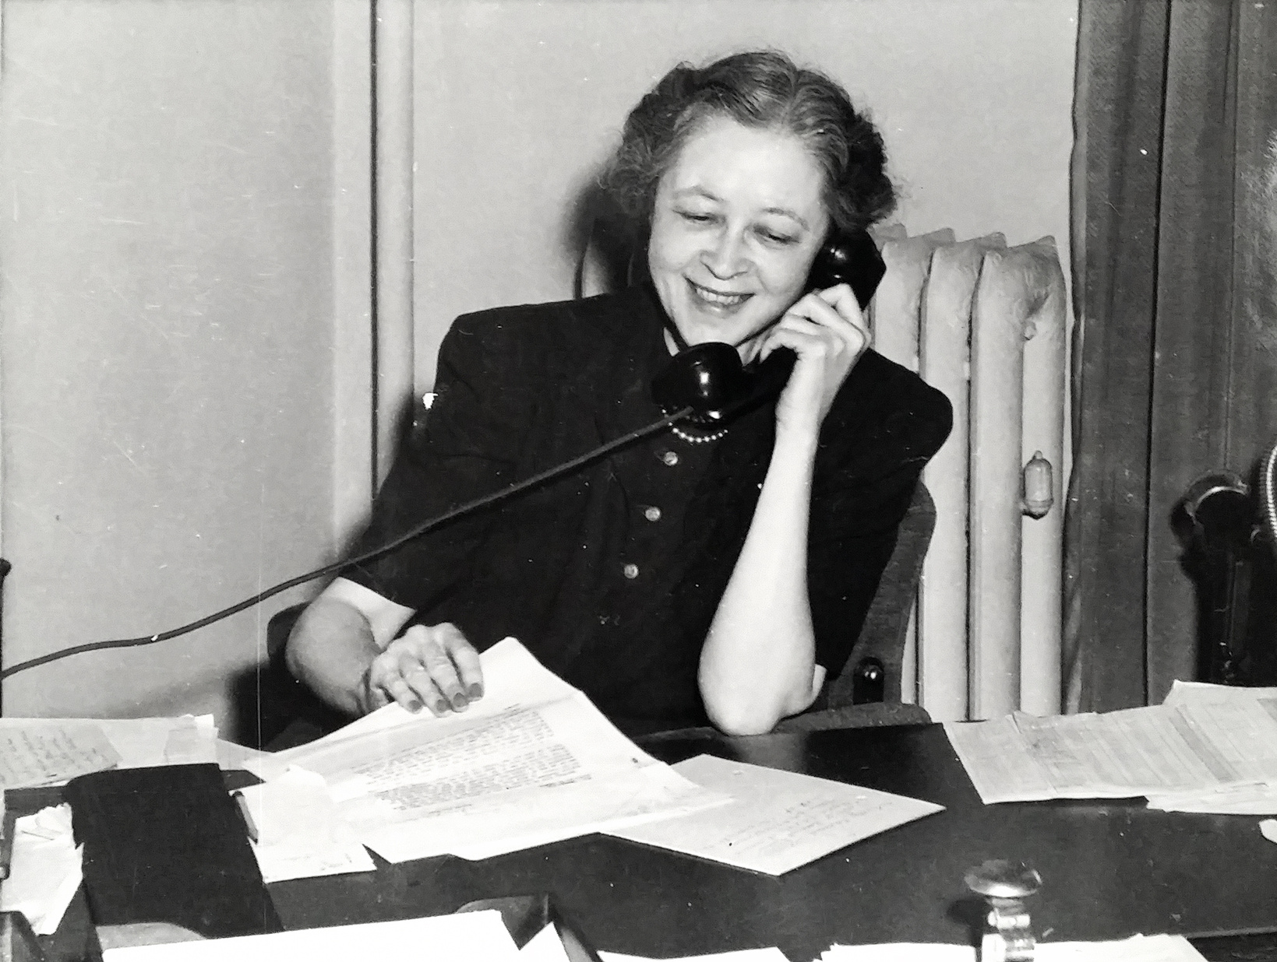

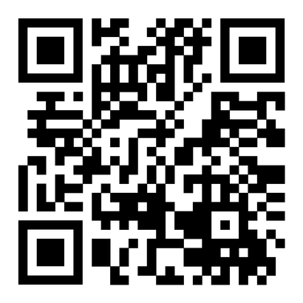
Ida C. Koran Trust
SUPPORT ECOLAB FAMILIES
Supporting Ecolab employees and retirees in times of unexpected financial hardship.
Donate Now
Hardship relief provided to nearly 500 associates,
and counting.
Ida C. Koran, Ecolab’s First Employee
Notes:
QR Code: Goes to the Ida C Koran page on the Ecolab Giving Site, if they’d like to make a donation.

Slide 2

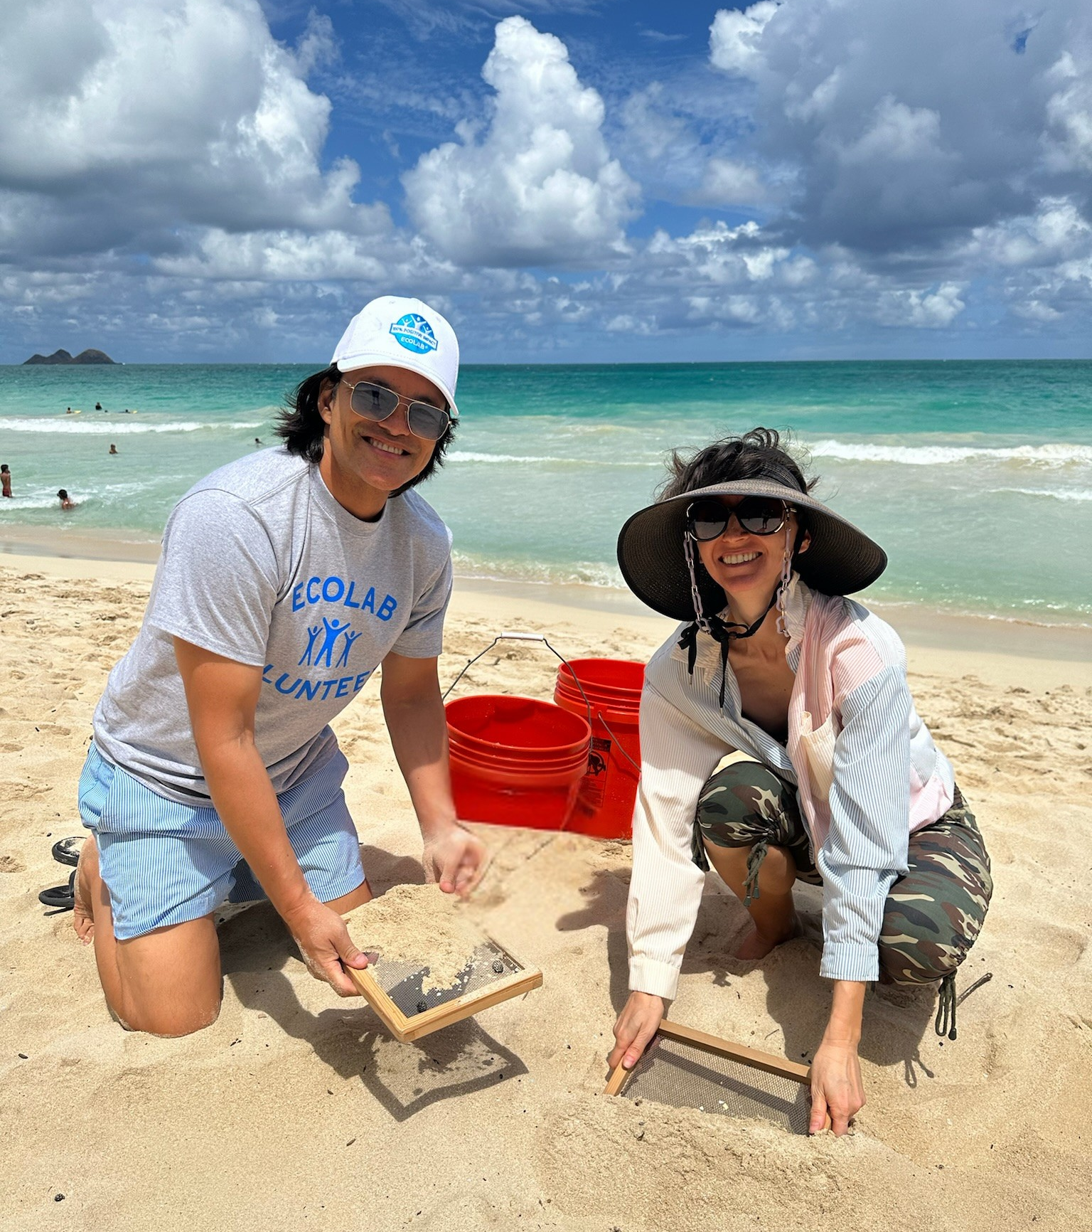
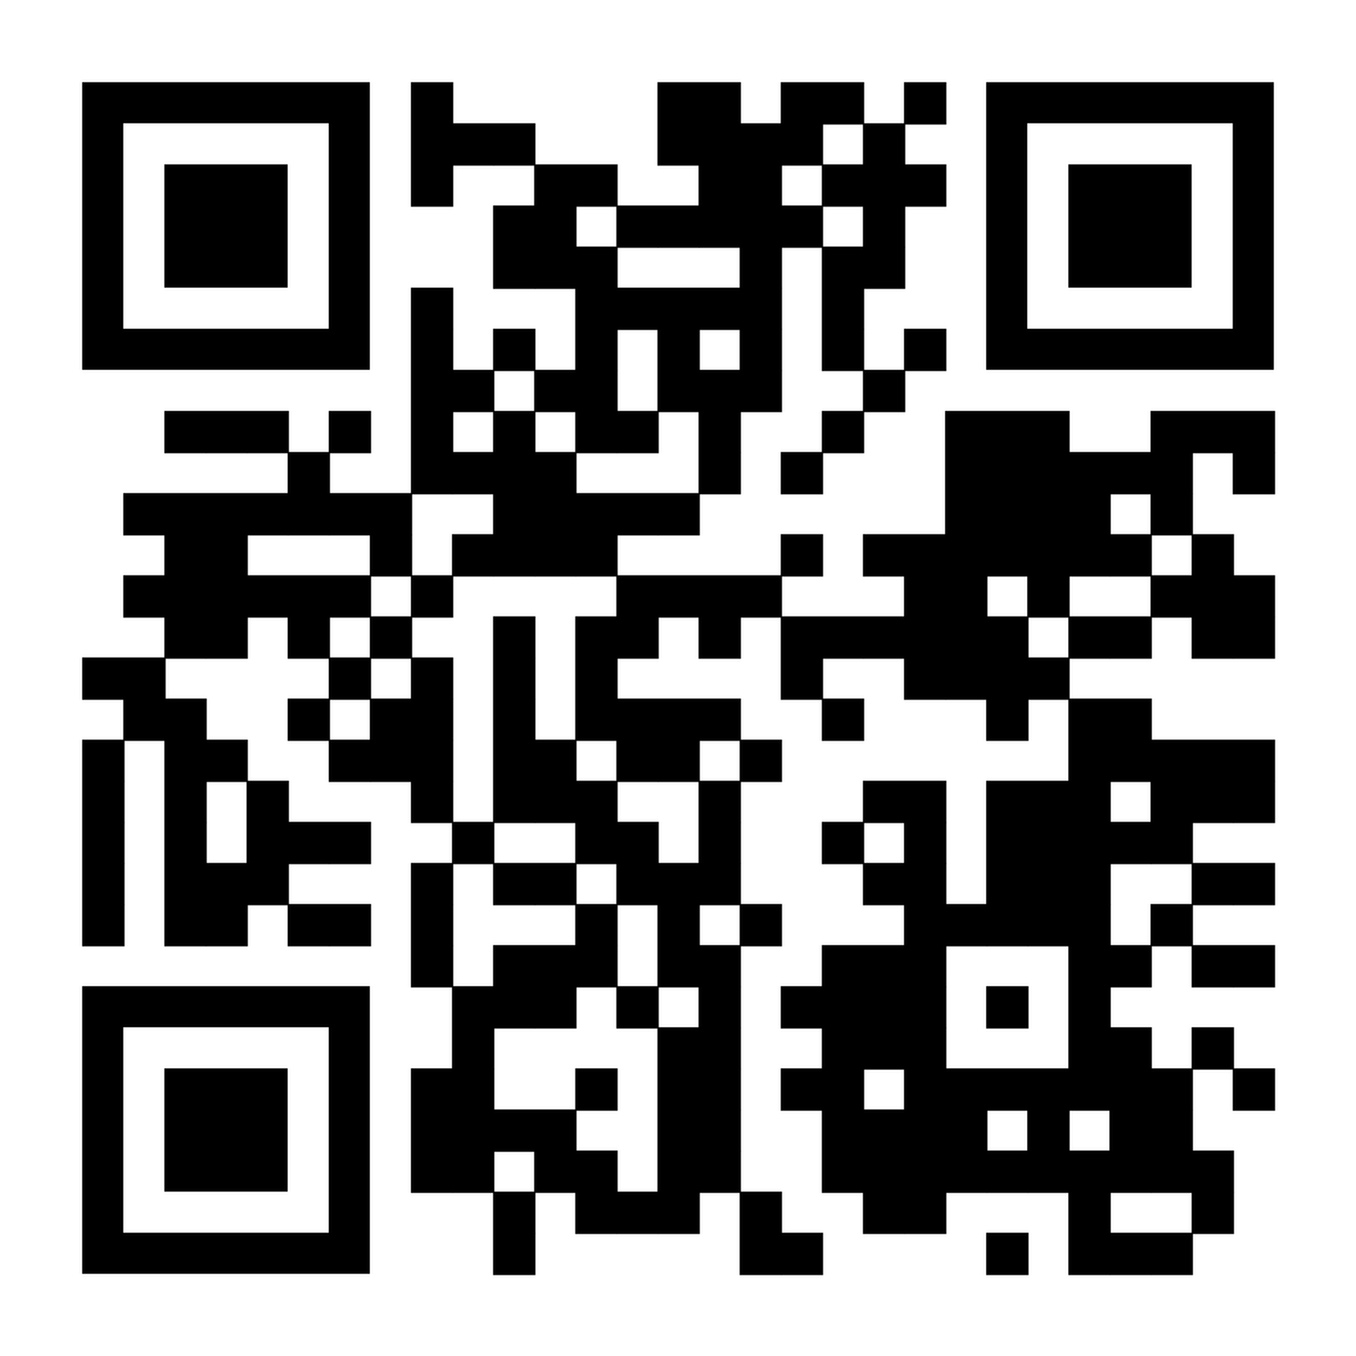
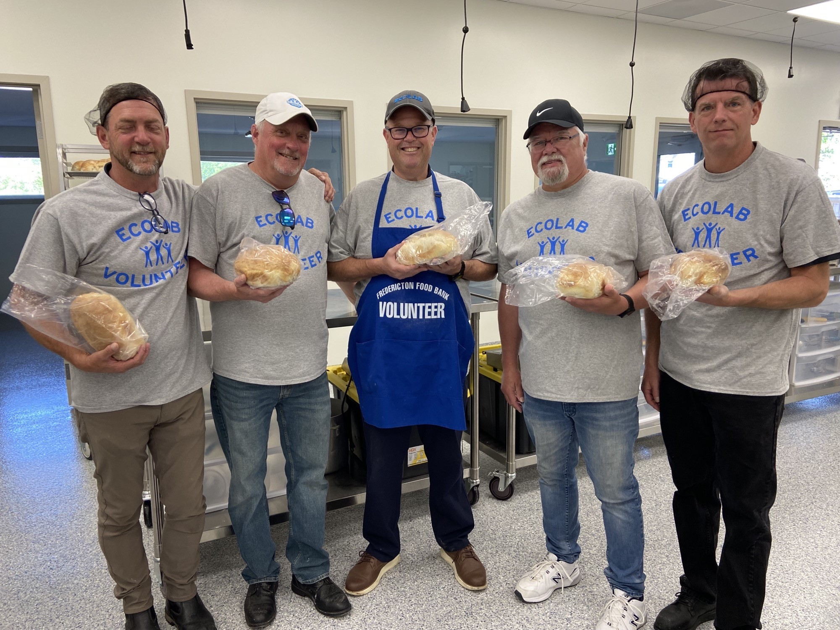
Global Community Giving Program: Your Impact, Matched
Maximize your community giving and volunteerism with up to $2,000 in matching funds
Give with a Match
100% Match Eligible
Up to $1,000 USD per calendar year
Give to Ida C Koran Today: Ecolab.YourCause.com
Volunteer to Earn a
'Dollars for Doers' Grant
1 Hour = $25 USD Grant
Up to $1,000 USD to eligible NGO's
Notes:
QR Code: Goes to the Ida C Koran page on the Ecolab Giving Site, if they’d like to make a donation.
- Donation Match: 100% match opportunity Only for donations made ON the Ecolab Giving Site, up to $1000 per calendar year. Some match restrictions apply. Check out Community Impact on INSIDE Ecolab for more details
- Dollars for Doers Volunteer Grant Opportunity: Don’t forget to log your volunteer hours and take advantage of the Dollars for Doers Incentive- $25 for each volunteer hour logged, up to $1000/employee/calendar year. Can then redeem those grants towards the nonprofit of your choice using the Ecolab Giving Site.

