Slide 1
Ida C. Koran Trust Disaster Relief Tool Kit 2024/25 storm season

Slide 2
Disaster Relief Program Overview
Responsive to employee needs for storm preparation & clean-up
Need based emergency financial relief to prepare for or to immediately follow a natural disaster event.
Program provides reimbursement up to US $2,500 for storm preparation, supplies or evacuation expenses.
Employee should track spending & save receipts
Assistance is a grant – no repayment required.
Global program available to all employees.
Notes:
The purpose of the disaster relief program is to provide emergency financial assistance to Ecolab employees affected by a natural disaster.
Ida Koran provides assistance for food, water, shelter, clothing and basic living essentials. Also provide relief to employee’s with house fires.
Disaster relief assistance is a financial need-based program.
This program is to not manage the inconvenience of spending money to prepare for a storm. It was designed to support employees that do not have the available funds/resources for storm preparation and recovery.

Slide 3
Disaster relief program
Eligibility Guidelines
No length of service requirement – global program
Employee household income should not exceed 500% of poverty level for US applicants. Income levels for global employees will be communicated by Ida Koran administrator
Support for the employee, their spouse/partner and employee’s dependent children.
Primary household only
Notes:
12 month eligibility requirement is waived during a natural disaster – typically the Trust requires at least 12 months of service to be eligible to apply to any of the Trust programs.

Slide 4
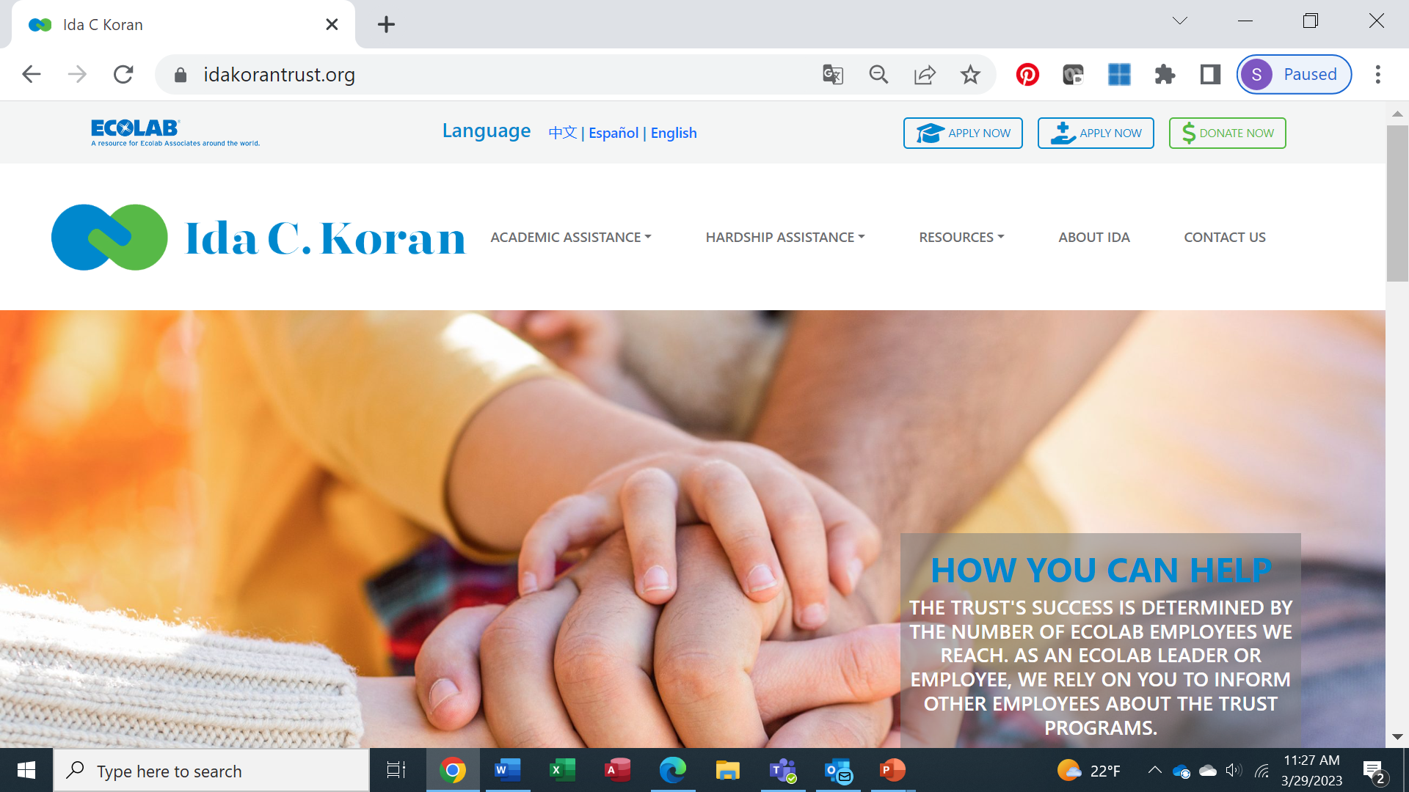
How Employees Apply
Disaster relief program
Visit www.idakoratrust.org – click apply now in the upper right-hand corner.
Create an account (username and password) and complete the application fields and click submit. Once received, the administrator will respond to your request within 48 hours.
Approved reimbursement will be wired to employees bank account.
Rebuilding and personal property loss support available through the Unexpected Hardship Program. Contact Ida Koran administrator for more information.
Notes:
After natural disaster occurs, contact should be made with the Trust Administrator (Sue Mortensen) to determine number affected by the disaster as well as identifying critical needs. Does a lump sum of assistance need to be sent to the area for distribution? Is electricity working?
Employees complete the on-line inquiry at www.idakorantrust.org . Contact is made with employee to discuss circumstances, living arrangements and financial needs.
Examples of reimbursement include: evacuation expenses, temporary shelter, fuel, food, water, clothing and/or basic necessities.
Assistance typically delivered by wire transfers to employee’s bank account.
Additional assistance for rebuilding and repairing damage or personal property loss can be pursued through hardship program. Unexpected hardship program can provide low interest loans and grants to employees. Each application is reviewed on a case by case basis.

Slide 5
Rebuilding Assistance program
Opportunity to request financial support (grant or loan) when faced with large repair or rebuilding expenses that home insurance will not support.
Employees are instructed to exhaust all home insurance or state funded resources.
Once an employee understands the total cost of the repairs/rebuild, the employee should complete an application on the Ida Koran website requesting additional funding.
Once submitted, the administrator will respond to the employee’s request with additional questions or feedback.

Slide 6
To Learn More About Ida Koran:
Contact sue.mortensen@ecolab.com or 651-250-2392
Visit Trust’s website – complete inquiry form www.idakorantrust.org
Confidential review and discussion of event
Administrator provide support to the employee to navigate application process and complete the request.
Notes:
Trust administrator is an employee of the Trust – not Ecolab.
All forms are sent directly to the Trust administrator for processing.
The Trust is committed to protecting the privacy and confidential nature of all hardship inquiries and applications.
Employees work directly with the Trust administrator to request financial support. The Trust does not share personal contact information with any leadership at Ecolab.

