Slide 1
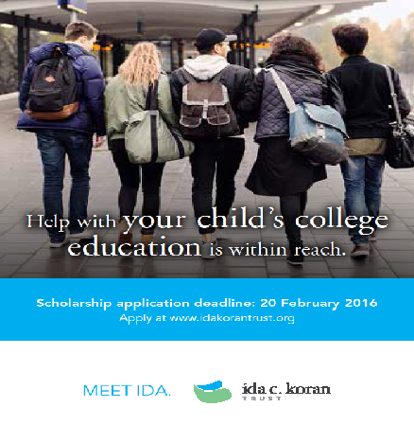

Academic Assistance Program
Educational opportunity for employee’s dependent children – trade, technical, vocational or traditional university programs
Program opened 15 October 2022,
Submission deadline: 21 February 2023
Global program for all eligible employees (with one year of service as of 20 April 2022)
Assistance ranges from $2,000 – $10,000(USD)
5-Year Distribution History
Notes:
Applicant participation to the academic assistance fluctuates each year but not drastically to cause concerned. Only dependent children of employees pursuing post secondary education apply and this causes fluctuating numbers.
Scholarship America ensures Ida Koran that we exceed the industry standard on applicant volume. However, we can always promote more and educate employees about the program opportunities.

Slide 2
Academic Assistance Program
Total number of applications received dictates the total number of awards received (1 out of 4 rule)
At least 10 awards are provided to trade, technical and vocational students applicants. Those applicants are evaluated separately. Goal is keep increasing awards in this category.
In last 10 years, program has helped over 3,500 students with over US $20 million in assistance.
Award renewal opportunities available – up to four years.
Notes:
Applicant participation to the academic assistance fluctuates each year but not drastically to cause concerned. Only dependent children of employees pursuing post secondary education apply and this causes fluctuating numbers.
Scholarship America ensures Ida Koran that we exceed the industry standard on applicant volume. However, we can always promote more and educate employees about the program opportunities.

Slide 3
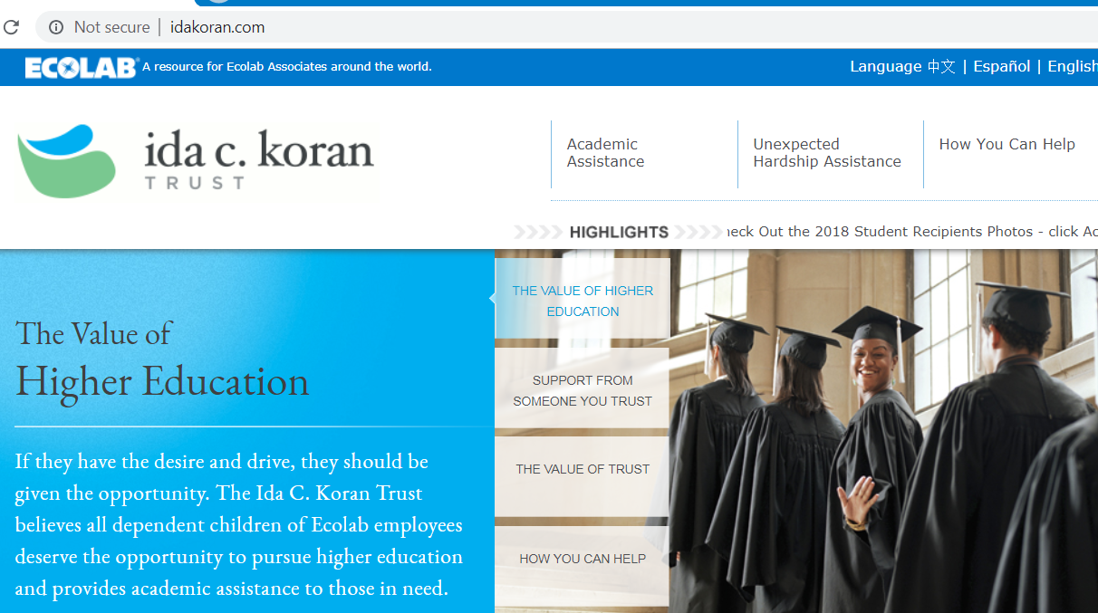
How Students Can Apply
HOW TO APPLY
1
Visit the Ida Koran Trust’s website: IdaKoran.com
2
Navigate to the Academic Assistance page
Academic
Assistance
3
Click on “Apply Now.”
4
Student create User ID & Password and complete all fields
Notes:
www.idakorantrust.org/academic-assistance

